Slide 1
Providing older
adults and family
caregivers with
Information and resources to
age well in their
Community
Add Logos to all pages
Notes:
Introduce Self:
The purpose of this presentation is to talk to you about the Chisago Age Well Coalition, the mission of CAW and ways we are working together to help you access resources before a crisis occurs.

Slide 2
As a nation we are growing older
“Today is the oldest you’ve ever been, and the youngest you’ll ever be again.”--Eleanor Roosevelt
United States - More than 52 million (15.6%) are 65 and older with 95 million projected to turn 65 by 2060
Minnesota - Nearly 806,000 are 65+ (15.4%), with 285,000 to turn 65 this decade
Chisago County - 8,300 are 65+ (15%)
Notes:
As you can see Minnesota and Chisago County are in line with the National % of individuals 65 and older. But what about the future?

Slide 3
What does this mean for the future?
“I intend to live forever--so far, so good!” Stephen Wright
By 2030, one of every five people in the U.S. will be 65 or older.
By 2035, the number of adults older than 65 will be greater than the number of children under 18.
*Source: AARP
Notes:
Stats from AARP
•76 million baby boomers began reaching the age of 65 in 2014 at the rate of 10,000 per day (Big Lake, Little Canada, North Branch, Arden Hills or Fairmont) 1946-1964
•They have changed our culture at every stage of their aging process (Ask audience to share their observations of changes and growth from 1946 to the present)
•We can only imagine the changes that will occur in the next 50+ years
•All of us (families, communities, health care, business, education, government, non-profit organizations, etc.) will be affected
•The generation behind BB’s is significantly smaller (Generation X 1965-1979); BUT, 80+ million comprise the Millennial generation (1982-2000) and outnumber the 75 million baby boomers.
Source: US Census Bureau www.census.gov
Our life expectancy is increasing
Chronic diseases are more prevalent
Increased awareness of mental health conditions
Importance of family caregivers
Dementia is affecting more of us

Slide 4
Chisago Age Well Coalition
How It Began:
2016 Community Conversations led by Collective Action Labs/Silos to Circles
Older adults and caregivers surveyed
Findings: Substantial services exist but knowledge of services is lacking
Notes:
In 2016, a group of community providers that serve older adults took part in discussions led by Collective Action Lab as part of a Silos to Circles initiative. The group discovered that, while substantial services for older adults exist, knowledge of available services was lacking. Outcomes- main concerns were isolation and /or lack of socialization, would primarily seek guidance in resources from their Dr. or Faith community.
Completed Surveys-with Older adults and Caregivers
Key Questions for Older Adults
What things keep you healthy and feeling good and independent? Do you have enough of the things that help you feel that way? If not, what is missing?
How do you get from place to place when you need to get around your community?
Think back to a time when you had an illness or another type of setback. What and who helped you move forward, and how did you get that help?
What or who do your friends and neighbors rely on? (For the interviewer: This may be an organization, such as a church or local club; people, like family and friends; or something else entirely, such as transportation services or a home health aide. Keep in mind: don’t provide examples unless asked to do so.)
What does it take to have a good day? How do you spend your time, and with whom?
What do you want or need in your daily life to thrive? As a senior in this community, what do you see as a need that you and other older adult’s experience that isn't being met or could be improved?
If you had a wish for how your life would be today/tomorrow, what would it be?
Is there anything else that you’d like to add that we haven’t covered?
Do you have suggestions for additional people we should speak with to assist in gathering feedback for needs of the community?
Key Questions for Caregivers;
Where do you see your aging loved one/area senior in five years?
What concerns do you have when you think about the older adult(s) (e.g. parent, friend, a person you serve professionally) in your life getting older?
What do you perceive their needs to be as they age? What currently helps or hinders their independence, or could do so in the future?
Have you reached out to access community resources? If not, why?
How do you want to learn about resources in your community that can help older adults maintain independence or support them when they are in need? Doctor, word of mouth.
o How/where would you prefer to find that information?
Would you prefer to have someone help you navigate the information?
What would make you interested in finding out what could help? If you have already sought this information, where did look or who did you contact?
What does the older adult(s) in your life ask for help with now? What do you believe they need help with that they may not be asking for?
Who are trusted resources for the older adult(s) in your life? Family? Friends? Clergy? Physician?
Conversations about needs and future plans can be difficult to have with aging loved ones. What do you need to feel equipped to have these conversations in a way that respects and empowers someone who is getting older?
Is there anything that you’d like to add that we didn’t discuss?

Slide 5
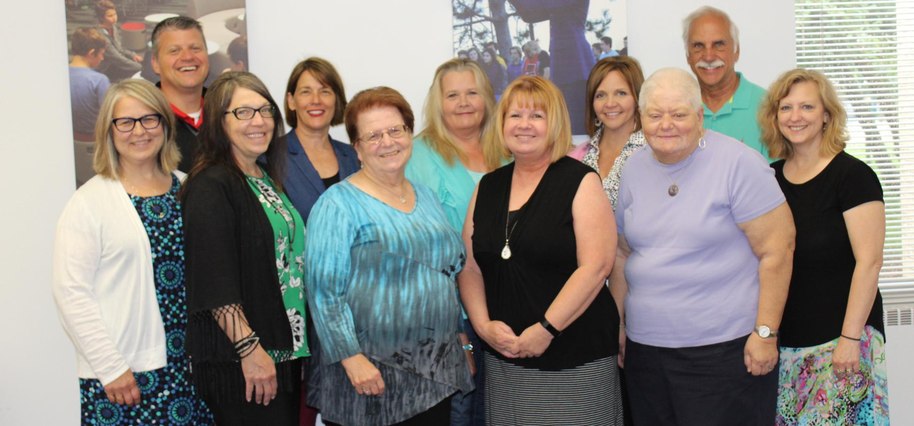
A Plan is Launched
LeadingAge MN Foundation funds a 24-
month plan
Chisago Age Well Coalition formed Jan 2018
Notes:
Toward the end of 2017 the group learned that there would be funds available to develop and implement the work plan discussed in 2016. The group reconvened to review and revise the workplan. Funds were approved through Leading Age Foundation MN.
The formal coalition group was confirmed in January 2018. Maybe an updated Pictures in 2019

Slide 6
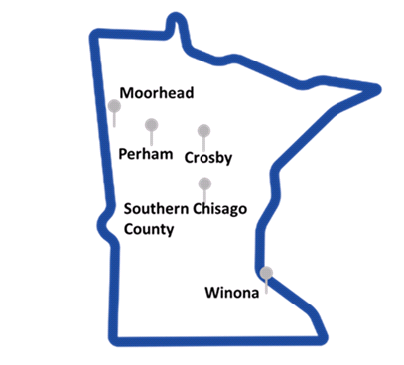
One of Five Pilot Communities
Notes:
The Coalition developed the name “Chisago Age Well” we are one of four communities who is a member of the SIlos to Circles PIlot project.
Moorhead, Perham, Crosby
You’ll notice there are five on this list. Winona was the first pilot community that went through the process several years ago.

Slide 7
Active Coalition Members
Brighton Hospice
Central Minnesota Council on Aging (CMCOA)
Senior Linkage Line
Community Education Programs
North Branch
Chisago Lakes Area
Chisago County Senior Center
Chisago County Public Health and State Health Improvement Program (SHIP)
Catholic Charities-Senior Dining
Ebenezer Meadows on Fairview
Ecumen
North Branch
Point Pleasant Heights
Parmly Lakeview Apts
Family Pathways
Fairview Health System
Good Samaritan Home Care
Heartland Express
Lakes & Pines, CAC
Monarch Healthcare Management
Second Harvest Heartland
St. Croix Regional Medical Center
Touching Hearts at Home
Notes:
Although there are close to 30 community agencies and members that have participated in the process along the way. These are the key coalition members at this time. As you can see there is a diverse group of agencies involved that work with or support older adults.

Slide 8
Our Mission
To increase awareness of, access to,
and satisfaction with existing services
and health resources in the community
To strengthen the relationships between senior community members, service providers, and health systems to benefit older adults and their caregivers
Notes:
Read Mission Statement. The goal is to assist community members and their caregivers to think about their wants and needs before the crisis. What assistance can be provided in the home of choice that can prolong or prevent hospitalization or long term care placement. Whether it’s someone to clean a home, assist with bathing or what about taking a dog for a walk, so the older individual can keep their pet longer.

Slide 9
Concerns of Seniors: Cost of Care
Out-of-pocket health care costs and deductibles continue to increase
Home care and assisted living services are typically not covered by insurance
Medicare is a short-term payer source with rules and criteria for payment that are continually shifting.

Slide 10
Estimated Costs
(In Central Minnesota Council on Aging Region)
“Old age is no place for sissies.”--Bette Davis
Assisted Living - average costs
$3,300 - $6,000/month
$39,600 - $72,000/year based on services
In-home care (non-nursing)
$5,000/month
$60,000/year
Skilled nursing facility
$6,700/month
$80,400/year
Senior Advisor & MetLife
Notes:
Keri will add memory care

Slide 11
Helping Seniors Age in Place
“Aging is not ‘lost youth’ but a new stage of opportunity and strength.” Betty Friedan
“90% of seniors and millennials want to remain in their own homes and live in their own communities” -- AARP
Aligning a community’s resources can help achieve that goal.
Notes:
•The generation behind BB’s is significantly smaller (Generation X 1965-1979); BUT, 80+ million comprise the Millennial generation (1982-2000) and outnumber the 75 million baby boomers.
Source: US Census Bureau www.census.gov

Slide 12
Senior LinkAge Line®
A no-fee service that provides confidential, unbiased information and assistance, connecting people to resources and programs based on individual need
A partner/resource to help seniors achieve and maintain independence
Connects consumers to programs that help them save money and stretch dollars
Provides education, advocacy, assistance, and follow-up

Slide 13
One-Stop Shopping for Seniors and Their Caregivers
Senior LinkAge Line - 1-800-333-2433
Medicare counseling
Housing options
Nutrition
Transportation
Financial assistance
Prescription drug help
In-person assistance
Caregiver support
Notes:
What do you know about Senior LinkAge Line?
SLL is more than just a call center.
The Call center is open Mon-Fri 8am-4:30pm
In our County we have a Senior LinkAge Line Advocate which means if needed you can meet in person for assistance with Medicare Health Plans and Finding Community Resources
Part of the Chisago Age Well project there are three outreach sites in Southern Chisago County for people to meet with the SLL Advocate- Chisago County Community Center (North Branch Senior Center) in North branch, Chisago Lakes Area Library and Wyoming Area Giese Memorial Library. Comment on the Flyer for the sites. ???

Slide 14
Do you or someone you know help a family member or friend with...
Grocery shopping and errands
Banking, paying bills
Medical appointments
Yard work and household chores
Personal care, dressing or bathing
Notes:
Think about yourself or people you know. Do you or others assist with any of the tasks listed?

Slide 15
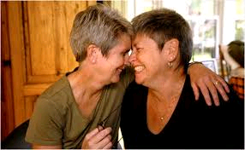
Do you know
a Caregiver?
Caregiving is the act of providing unpaid assistance and support to family members or acquaintances who have physical, psychological, or developmental needs. Caring for others generally takes on three forms: instrumental, emotional, and informational caring.
Notes:
Now who do you know who is a caregiver?
Think about the questions we just asked. If you or someone you know does any of the tasks mentioned this is caregiving
What are other tasks that a caregiver might help with? Explain instrumental, emotional and informational.

Slide 16
Community Resources
for Caregivers include:
Caregiver Consultation Services through Family Pathways
www.familypathways.org
Group Respite through Lakes & Pines CAC
Support Groups http://www.cmcoa.org/helpcaregiving.shtml
Notes:
Mention- the Group Respite through Lakes & Pines and Caregiver Consultation through Family Pathways
In Minnesota we have a unique service. Professional staff that assist the caregiver. Family Pathways is the provider for southern Chisago County. The best place to call for resources is SLL.
Caregiver Consultants- can help you: From MBA website
Look at your situation and identify issues of concern to you
Find solutions to problems
Feel more in control
Find resources to assist you in providing care
2. Support Groups- There are various support groups in the region. Family Pathways Caregiver Consultants offer groups within the region.
3. Education
Powerful Tools for Caregivers--Classes can be found at www.cmcoa.org- calendar
Powerful Tools for Caregivers® is an education program to help family and friends caring for older adults with long-term health conditions (e.g., stroke, Alzheimer’s, Parkinson’s disease, and others).
Powerful Tools helps caregivers develop skills and confidence to better care for themselves while caring for others. It is a six-week series led by trained facilitators using a standardized curriculum. The weekly topics range from reducing your stress to communicating in challenging situation and mastering
4. Respite Services- 8n
Respite care is an essential part of the overall support that families may need to keep their family member with a disability at home. The word "respite" means to take a break from the daily challenges of caring for a child or a parent with special needs. It can be planned for a few hours or for as long as a weekend. https://www.people-inc.org/disabilities_services_home/respite_services/what_is_respite/index.html.
In Home and Community Respite- Contact SLL In Southern Chisago county two providers that offer services are Lake & Pines- Group respite and Family Pathways -In Home Respite. There are other types of in-home and facility respite services contact SLL to request resources.

Slide 17
Older adults and their caregivers aren’t alone. There’s help out there.
Senior LinkAge Line (SLL) Advocate
Caregiver Support
Chisago Age Well Quick Look Reference Guide
Classes and community events
Dine & Discovers
Speakers, programs and resource fairs
Web Portal www.chisagoagewell.org
Facebookwww.facebook.com/Chisago Age Well

Slide 18
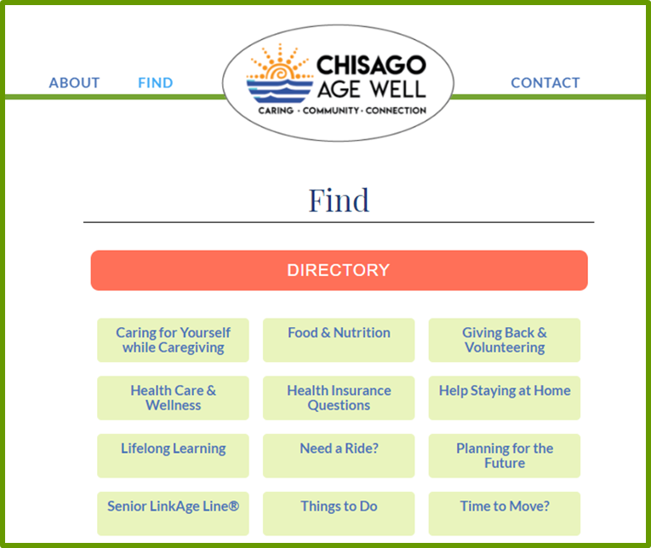

Slide 19
Volunteer Opportunities
South Chisago County Meals on Wheels Family Pathways Food Shelf, Aging Services
Fairview Lakes Volunteers
Foster Grandparents
Community Meals Mondays Zion
Evangelical Lutheran Church
See chisagoagewell.org for more information
Notes:
Take out numbers confirm on website to see and refer them to website rebecca will check website

Slide 20
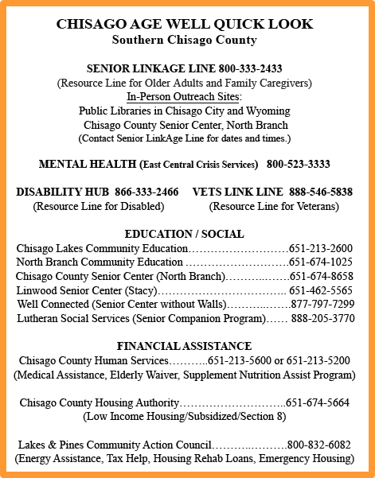
Quick Reference Guide
Notes:
There are copies of the Quick Reference Guide for you to take with you. The goal is to get this information to community businesses and consumers. This slide shows the resource categories the quick guide currently lists.

Slide 21
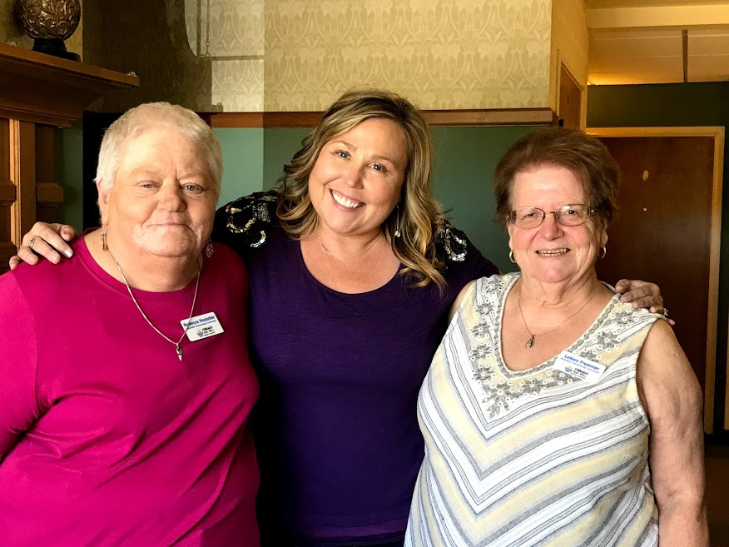
We’re Spreading the Message
Volunteer Community Connectors
Rebecca Hostetler
rebeccah@chisagoagewell.org
Keri Huebl
kerih@chisagoagewell.org
Leilani Freeman
leilanif@chisagoagewell.org.
Notes:
Meet the Team. The Volunteer Community Connectors work closely with the Chisago Age Well Coalition. They assist with subcommittees to implement the the mission and goals. Most importantly we are offering presentation such as today to get the word out of the exciting things happening through the Coalition and getting people connected.

Slide 22
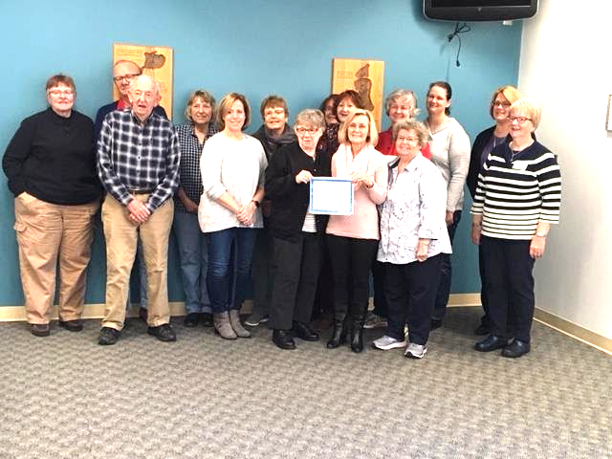
What Does the Community Think
What have you learned from the Chisago Age well?
That there are so many programs out there, so much information
and resources available. Everyone works together as a team,
one united front, to assist in any way possible, which I find so refreshing!
I have picked up something new at every single meeting.
Knowledge is power!
How would you describe the benefits of the project for the local
communities?
Absolutely wonderful! One realizes they are not alone with an aging parent,
an aging spouse, becoming a senior citizen yourself. One is not judged.
Thanks for all you do for Seniors, we are all better for your kindness.
Notes:
Feedback from community members who have participated in Dine & Discover events

Slide 23
The future of Chisago Age Well:
Sustainability and Strategic Planning
–Explore future resources and collaborations
–Pursue 501(3)c status
-Expand the coalition membership
Notes:
This is the goals of the CAW coalition

Slide 24
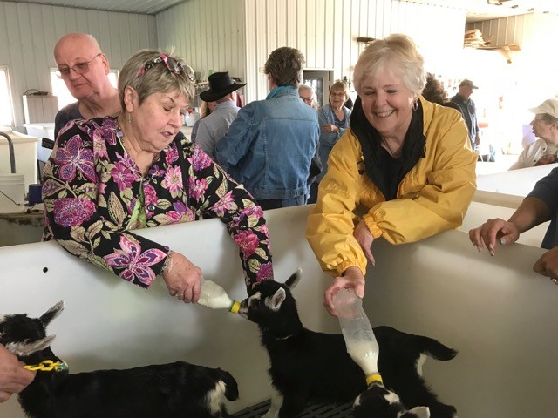
Taking the next step
“Aging is an adventure.” Connie Goldman
Learn
Connect
Participate
Support
Notes:
There is a sign-up sheet if you are interested in future events, information on the coalition or presentations to additional groups in the area. How to get involved: provide supports- inkind, donations, funding ideas- grants. Mention upcoming events.

Slide 25
QUESTIONS

